Slide 1
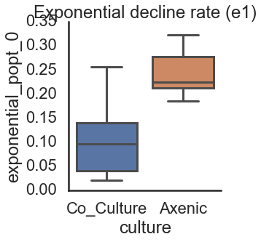
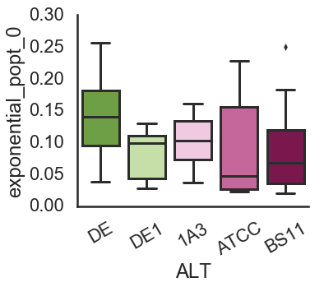
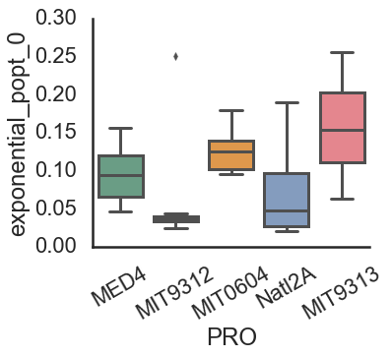
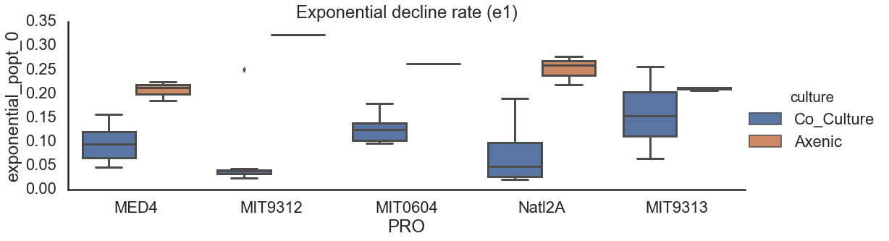
A
A
A
A
A
AC
C
AB
AC
B
MIT9313-MED4 0.012255
MIT9312-MIT0604 0.002162
MIT9313-MIT9312 0.000002
Natl2A-MIT9313 0.000228

Slide 2
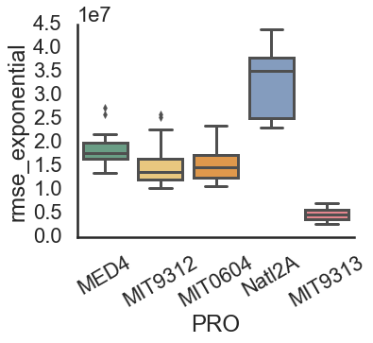
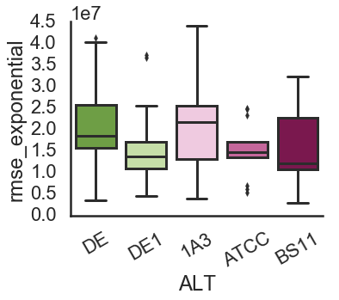
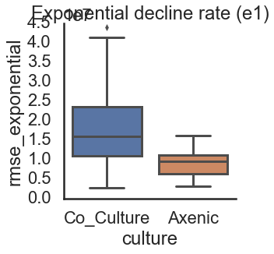
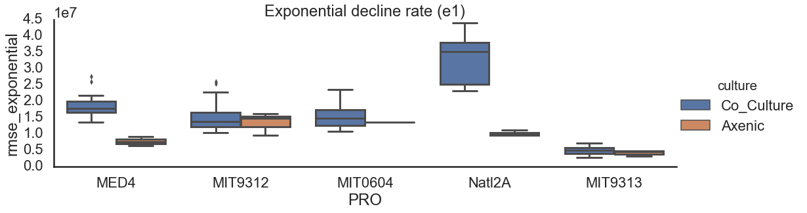
A
A
A
B
C
Error in the fitting of exponential function
A
A
A
A
A
MIT9313-MED4 1.715292e-10
Natl2A-MED4 5.188325e-11
MIT9313-MIT0604 6.512815e-07
Natl2A-MIT0604 1.583147e-13
MIT9313-MIT9312 3.295529e-07
Natl2A-MIT9312 2.744955e-14
Natl2A-MIT9313 2.480768e-24

Slide 3
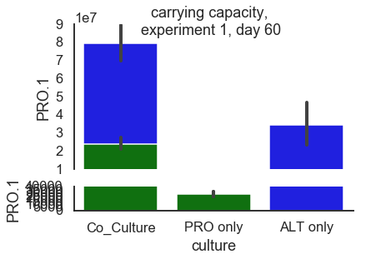
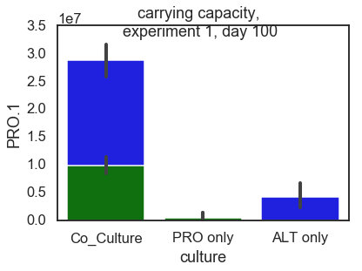
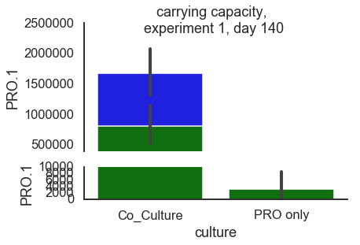
Total number of cells carrying capacity per day

Slide 4
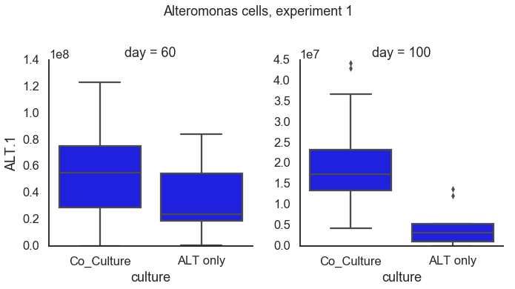
ALT co-culture vs axenic
day=60 : Ttest_indResult(statistic=2.7387394490570838, pvalue=0.007529210600903086)
day=100 : Ttest_indResult(statistic=6.2055728134674775, pvalue=1.9772383801176403e-08)

Slide 5
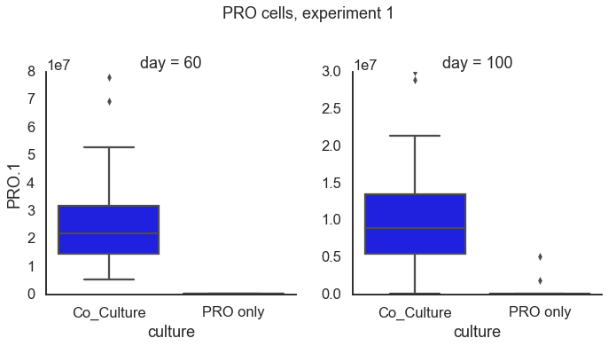
PRO co-culture vs axenic
day=60 Ttest_indResult(statistic=6.513651102735099, pvalue=4.737550066995795e-09)
day=100 Ttest_indResult(statistic=5.429712102261257, pvalue=5.150855380193557e-07)

Slide 6
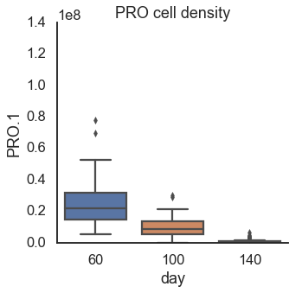
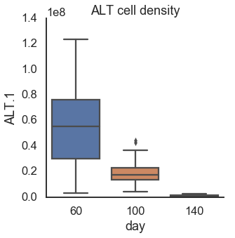

Slide 7
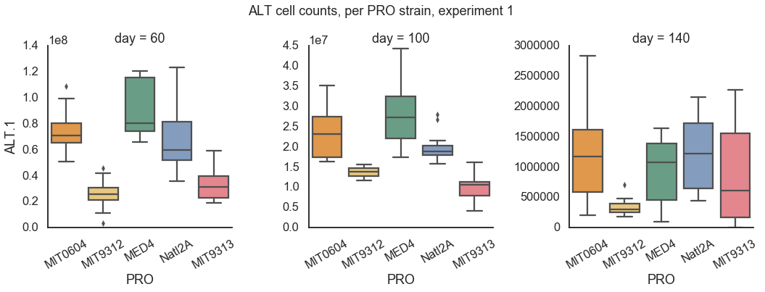
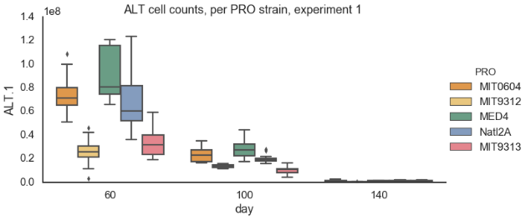
day=60
MIT9312-MED4 2.979887e-13
MIT9313-MED4 4.044107e-11
Natl2A-MED4 1.864648e-02
MIT9312-MIT0604 1.604945e-08
MIT9313-MIT0604 1.692750e-06
Natl2A-MIT9312 1.094969e-07
Natl2A-MIT9313 1.397843e-05
day=100
MIT9312-MED4 1.136526e-10
MIT9313-MED4 1.098858e-14
Natl2A-MED4 8.780070e-05
MIT9312-MIT0604 3.664213e-05
MIT9313-MIT0604 6.278300e-09
Natl2A-MIT9312 1.327496e-02
Natl2A-MIT9313 4.431006e-06
day=140
MIT9312-MIT0604 0.006170
Natl2A-MIT9312 0.004391

Slide 8
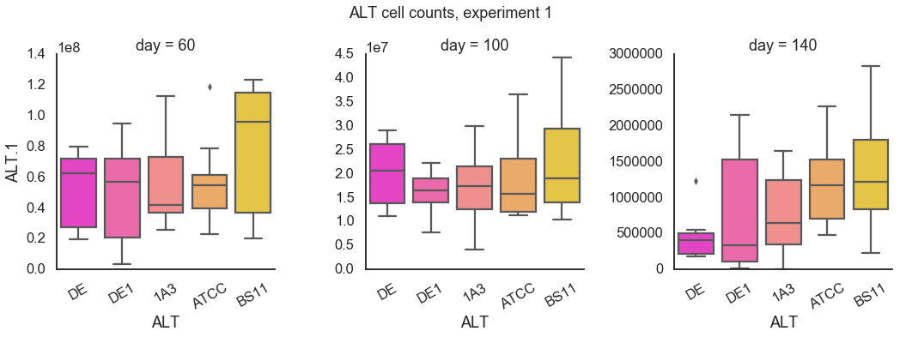
ALT cells as function of ALT strain, day=60
DE1-BS11 0.026893
ALT cells as function of ALT strain, day=140
DE-ATCC 0.015878
DE-BS11 0.001400
ALT cells as function of ALT strain, day=100

Slide 9
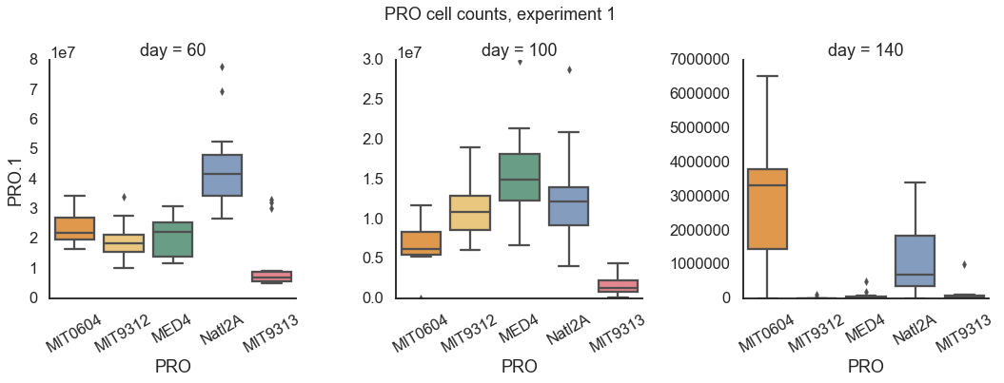
PRO cells as function of PRO strain, day=60
Natl2A-MED4 3.651113e-04
Natl2A-MIT0604 3.004083e-03
Natl2A-MIT9312 1.138943e-04
Natl2A-MIT9313 3.337528e-07
PRO cells as function of PRO strain, day=100
MIT0604-MED4 7.931135e-03
MIT9313-MED4 4.218253e-07
MIT9313-MIT9312 7.736621e-04
Natl2A-MIT9313 2.501980e-05
PRO cells as function of PRO strain, day=140
MIT0604-MED4 7.503304e-08
MIT9312-MIT0604 4.592467e-08
MIT9313-MIT0604 1.271490e-07
Natl2A-MIT0604 2.728215e-03

Slide 10
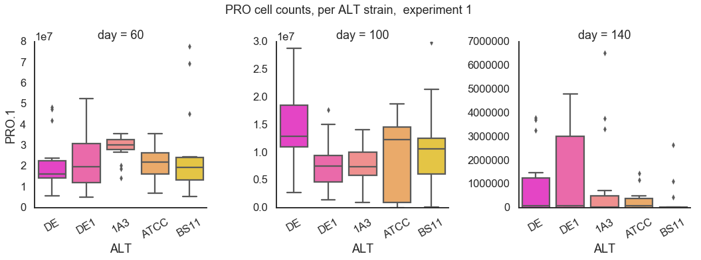
PRO cells as function of ALT strain, day=60
PRO cells as function of ALT strain, day=100
PRO cells as function of ALT strain, day=140

Slide 11
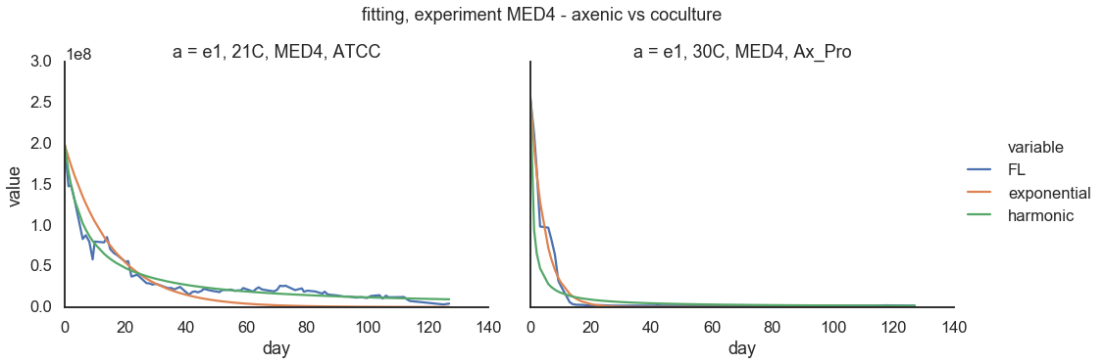
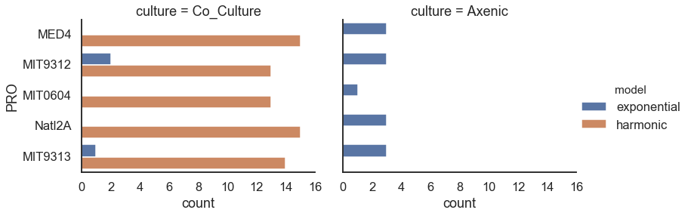
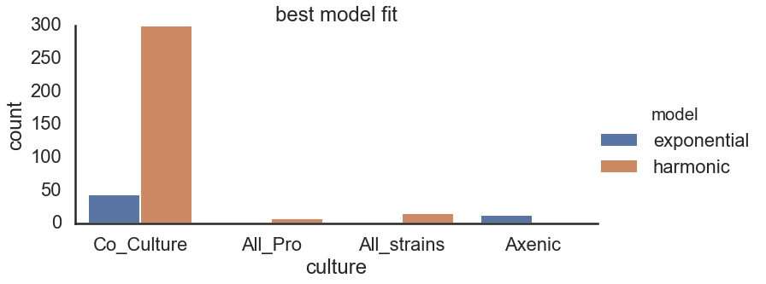
PRO cells
Exponential vs harmonic – cell numbers
Experiment 1

Slide 12
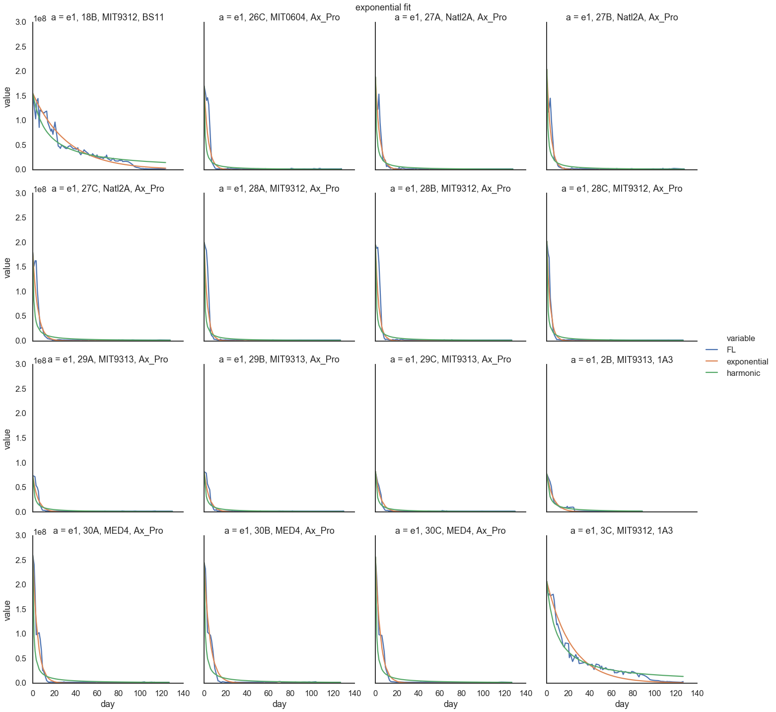
Exponential
fit

Slide 13
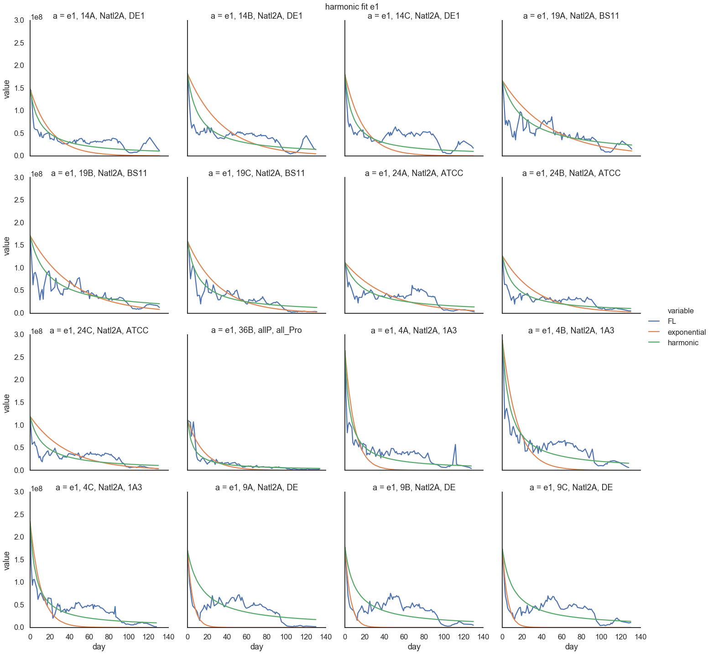
Harmonic fit

Slide 14
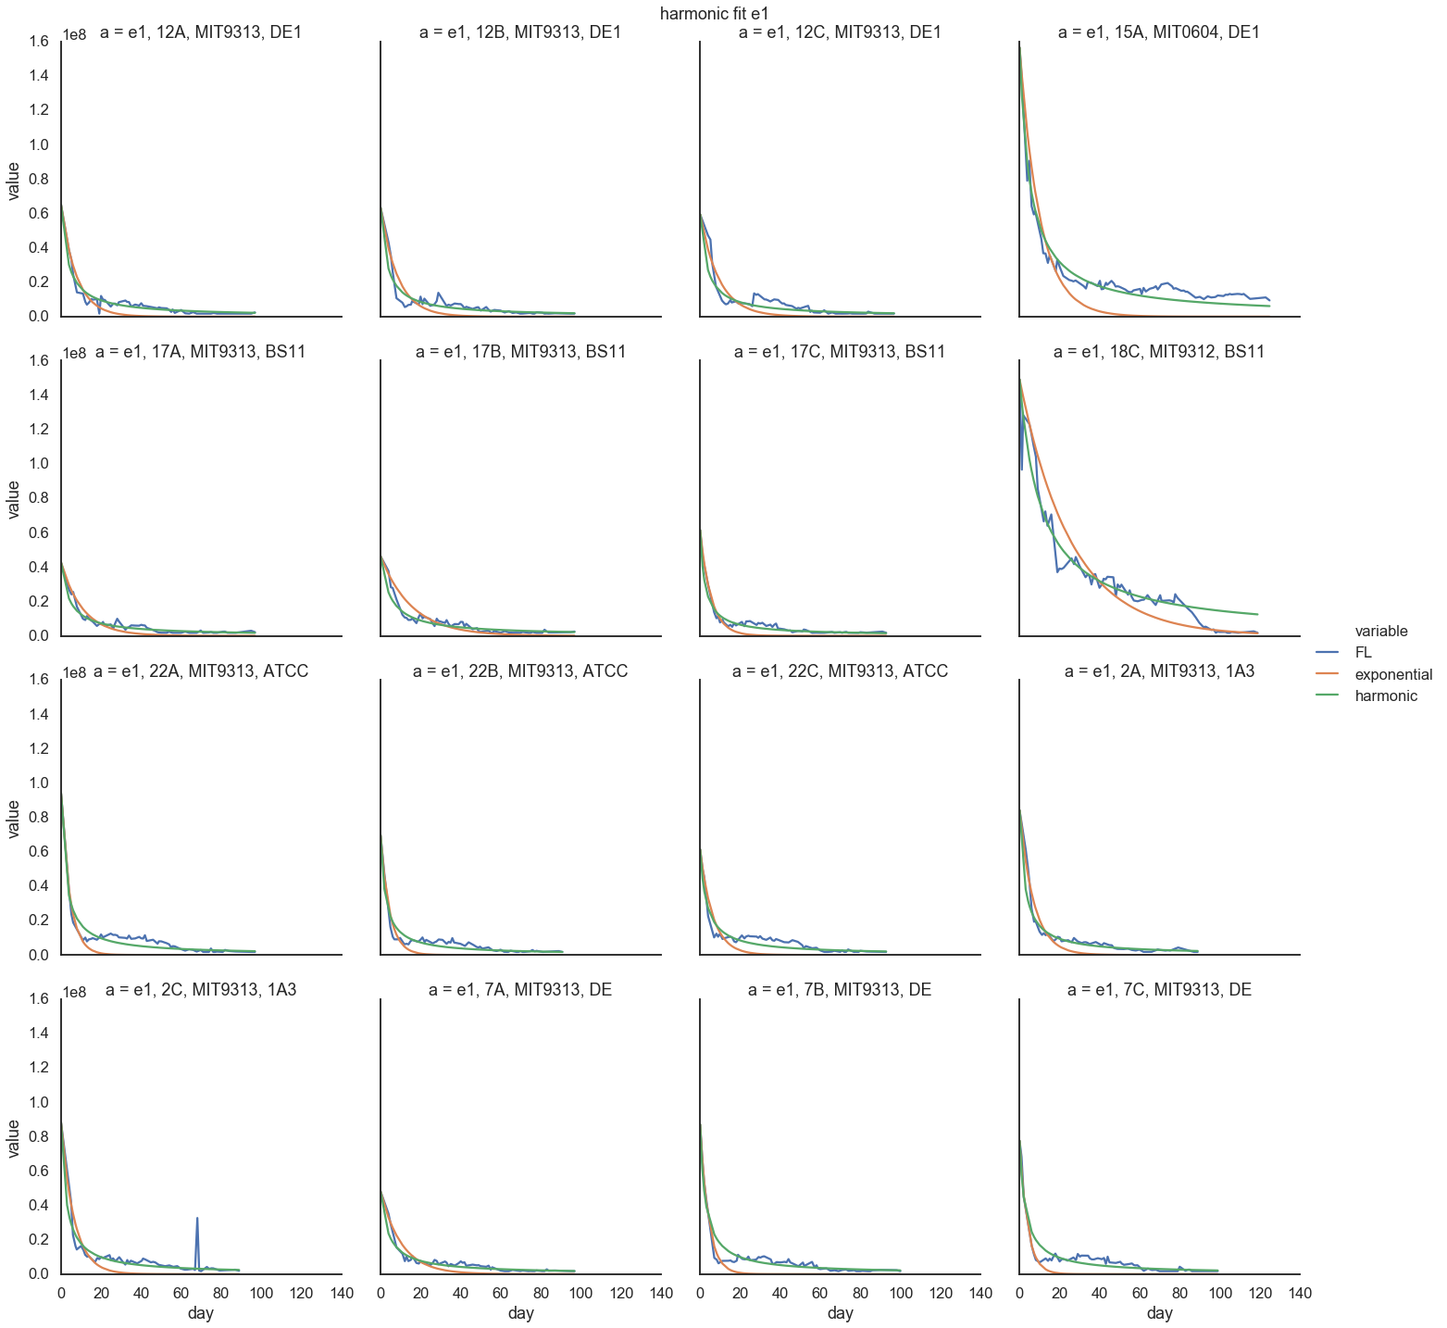
Harmonic fit

Slide 15
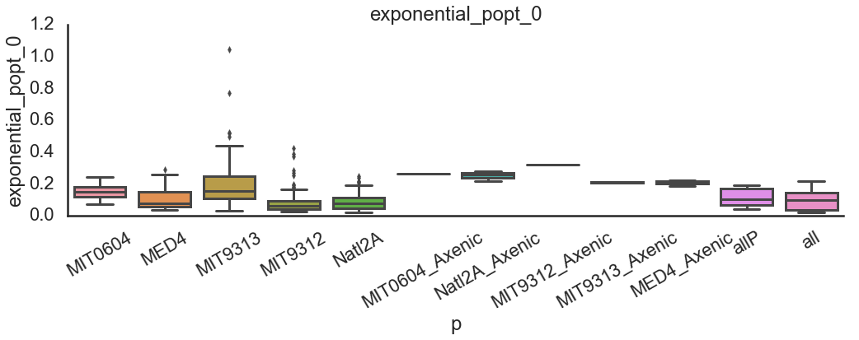
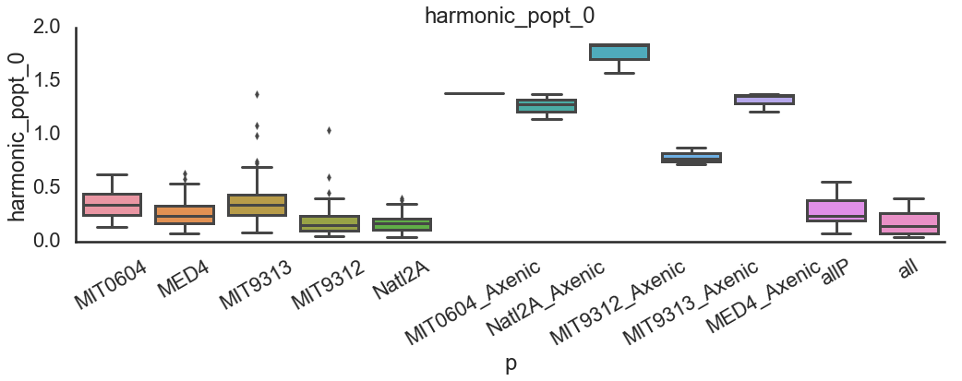

Slide 16
